Slide 1

Two-stage fine-tuning with ChatGPT
A novel method for learning class-imbalanced data
Taha ValizadehAslani, Yiwen Shi, Jing Wang, Ping Ren, Yi Zhang, Meng Hu, Liang Zhao, Hualou Liang. "Two-stage fine-tuning: A novel strategy for learning class-imbalanced data" Neurocomputing.

Slide 2
Effect of imbalanced train data
Poor performance on the minority class
Good performance on all classes
Model learns all classes
Model does not learn minority classes
Balanced train data
Imbalanced train
data

Slide 3
Existing solutions
Imbalanced data remedies
Resampling
Reweighting
Data augmentation
Up-sampling
Inverse class frequency
Token level
Down-sampling
Effective number of samples
Sentence level
Margin based reweighting

Slide 4
Motivations
Reweighting has a significant effect early in training, and its impact diminishes over successive epochs of training
Effect of reweighting diminishes
Minority collapse
Fine-tuning distorts features
The minority classes collapse to a single vector in the topmost layer.
Fine-tuning can distort the pretrained features and lead to poor OOD accuracy
Fang, C., He, H., Long, Q., & Su, W. J. (2021). Exploring deep neural networks via layer-peeled model: Minority collapse in imbalanced training. Proceedings of the National Academy of Sciences, 118(43).
Byrd, J., & Lipton, Z. (2019, May). What is the effect of importance weighting in deep learning?. In International conference on machine learning (pp. 872-881). PMLR.
Kumar, A., Raghunathan, A., Jones, R., Ma, T., & Liang, P. (2022). Fine-tuning can distort pretrained features and underperform out-of-distribution. arXiv preprint arXiv:2202.10054.

Slide 5
Proposed solutions
Pretrained model
Standard
fine-tuning
Pretrained model
Pre-fine-tuning with ChatGPT data augmentation
Standard
fine-tuning

Slide 6

Data generation example
Augmented data 1
The message is trite and the material is unoriginal.
Original data
Augmented data 2
banal in its message and the choice of material
The message and material are devoid of originality or interest.
Augmented data 3
Uninspired message and mundane selection of material.

Slide 7

Bidirectional Encoder Representations from Transformers (BERT)
As an example model, we use on BERT
BERT revolutionized NLP field and marked the beginning of a new era in NLP
12 layers, 110 million parameters (BERT base)
Pre-trained on English BooksCorpus (800M words) + Wikipedia (2,500M words)
Used in Google search
Devlin, J., Chang, M. W., Lee, K., & Toutanova, K. (2018). Bert: Pre-training of deep bidirectional transformers for language understanding. arXiv preprint arXiv:1810.04805.

Slide 8
Training stages
Classification head
Classification head
Classification head
Layer 12
Layer 12
Layer 12
Pretrained model
Layer 11
Layer 11
Layer 11
Layer 10
Layer 10
Layer 10
Layer 9
Layer 9
Layer 9
Layer 8
Layer 8
Layer 8
Pre-fine-tuning with ChatGPT data augmentation
Layer 7
Layer 7
Layer 7
Pre-trained model
Layer 6
Layer 6
Layer 6
Layer 5
Layer 5
Layer 5
Pre-fine-tuning
Layer 4
Layer 4
Layer 4
Standard
fine-tuning
Layer 3
Layer 3
Layer 3
Standard fine-tuning
Layer 2
Layer 2
Layer 2
Layer 1
Layer 1
Layer 1

Slide 9
Alternative implementation (back translation)
The augmented data is obtained by translating the text to another language…
And then translate back to English

Slide 10
Alternative implementation (RW)
No data augmentation
Original data in both stages
Pre-fine-tuning with reweighting
We used LDAM
Fine-tune with conventional loss function

Slide 11
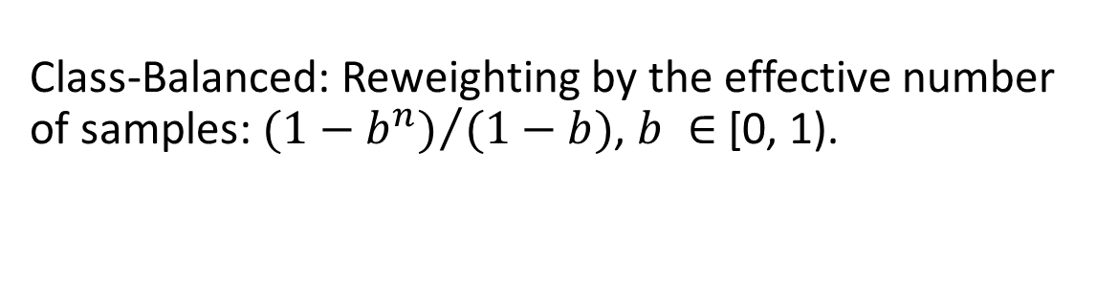
Comparison with other methods
Vanilla fine-tuning
Fine-tuning the whole model
CB
Class-Balanced: Reweighting by the effective number of samples: ${(1−b^{n})}/{(1−b)}$, $b ∈$ [0, 1).
label-distribution-aware margin, which encourages the minority classes to have larger margins than the majority classes.
LDAM
Cui, Y., Jia, M., Lin, T. Y., Song, Y., & Belongie, S. (2019). Class-balanced loss based on effective number of samples. In Proceedings of the IEEE/CVF conference on computer vision and pattern recognition (pp. 9268-9277).
Cao, K., Wei, C., Gaidon, A., Arechiga, N., & Ma, T. (2019). Learning imbalanced datasets with label-distribution-aware margin loss. Advances in neural information processing systems, 32.

Slide 12
Synthetic Benchmark 1: SST-2
The Stanford Sentiment Treebank 2 (SST-2)
Sentences from movie reviews
Human annotations of the sentiments : positive or negative
To create an imbalanced training set, we randomly removed negative reviews
Number of negative samples was one-fifth of the number of positive samples
The test dataset remained unchanged

Slide 13
SST-2 Results
Fine-tuning method​ | Macro F1 | F1 negative | F1 positive
Vanilla ​ | 0.8812 (0.0027)​ | 0.8698 (0.0035) | 0.8926 (0.0019)
CB | 0.8891 (0.0026)​ | 0.8798 (0.0032) | 0.8985 (0.0019)
LDAM | 0.8855 (0.0040)​ | 0.8750 (0.0050) | 0.8960 (0.0030)
Two-stage (back translation) | 0.8925 (0.0026) | 0.8831 (0.0031) | 0.9019 (0.0022)
Two-stage (RW) ​ | 0.8941 (0.0035)​ | 0.8843 (0.0041) | 0.9038 (0.0028)
Two-stage (ChatGPT) | 0.8957 (0.0033)​ | 0.8864 (0.0040) | 0.9051 (0.0026)

Slide 14
SST-2 - Out-of-distribution
OOD samples
Different distribution than the training data
Unseen during training
Critical test for the generalization ability
Models trained on SST-2 data
Tested them on a different sentiment analysis dataset: Internet Movie Database (IMDB) reviews.
Fine-tuning method​ | Macro F1 | F1 negative | F1 positive
Vanilla ​ | 0.8193 (0.0031) | 0.8077 (0.0046) | 0.8310 (0.0018)
CB | 0.8210 (0.0027) | 0.8110 (0.0042) | 0.8310 (0.0017)
LDAM | 0.8216 (0.0027) | 0.8119 (0.0042) | 0.8312 (0.0017)
Two-stage (RW) ​ | 0.8196 (0.0011) | 0.8051 (0.0018) | 0.8200 (0.0009)
Two-stage (ChatGPT) | 0.8266 (0.0028) | 0.8165 (0.0041) | 0.8367 (0.0018)

Slide 15
Synthetic Benchmark 2: The 20 Newsgroups
Collection of news classified into 20 groups
Science, religion, technology…
Manually imbalanced train set by down-sampling
Two types of imbalanced distribution were used:
  The step imbalance: half of the classes are minority and half are majority
  The long-tailed imbalance: class sample sizes follow an exponential decay
Lang, K. (1995). Newsweeder: Learning to filter netnews. In Machine learning proceedings 1995 (pp. 331-339). Morgan Kaufmann.

Slide 16
Macro F1 results
Fine-tuning method​ | Macro F1 (step)​ | Macro F1 (long-tailed)​
Vanilla ​ | 0.6055 (0.0186)​ | 0.5855 (0.0161)​
CB | 0.6698 (0.0157)​ | 0.6729 (0.0132)​
LDAM | 0.6662 (0.0141)​ | 0.6724 (0.0145)​
Two-stage (back translation) | 0.6579 (0.0137) | 0.7147 (0.0163)
Two-stage (RW) ​ | 0.7418 (0.0038)​ | 0.7305 (0.0022)​
Two-stage (ChatGPT) | 0.7674 (0.0021)​ | 0.7667 (0.0011)​

Slide 17
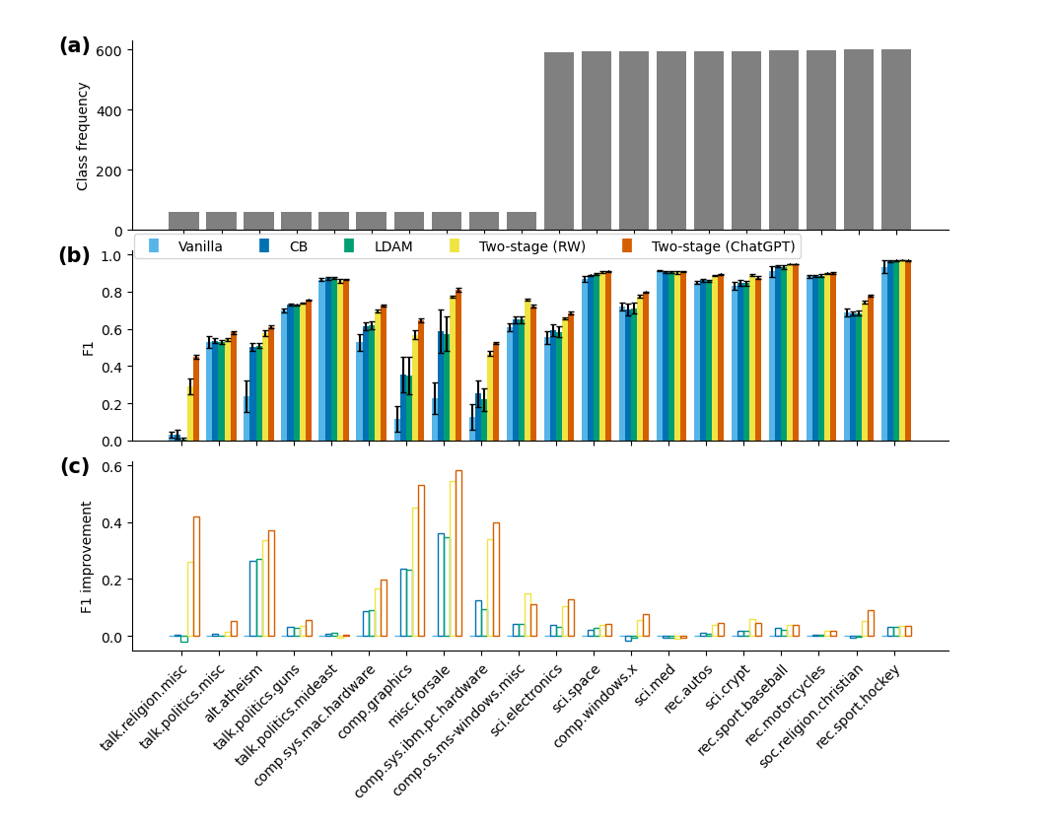
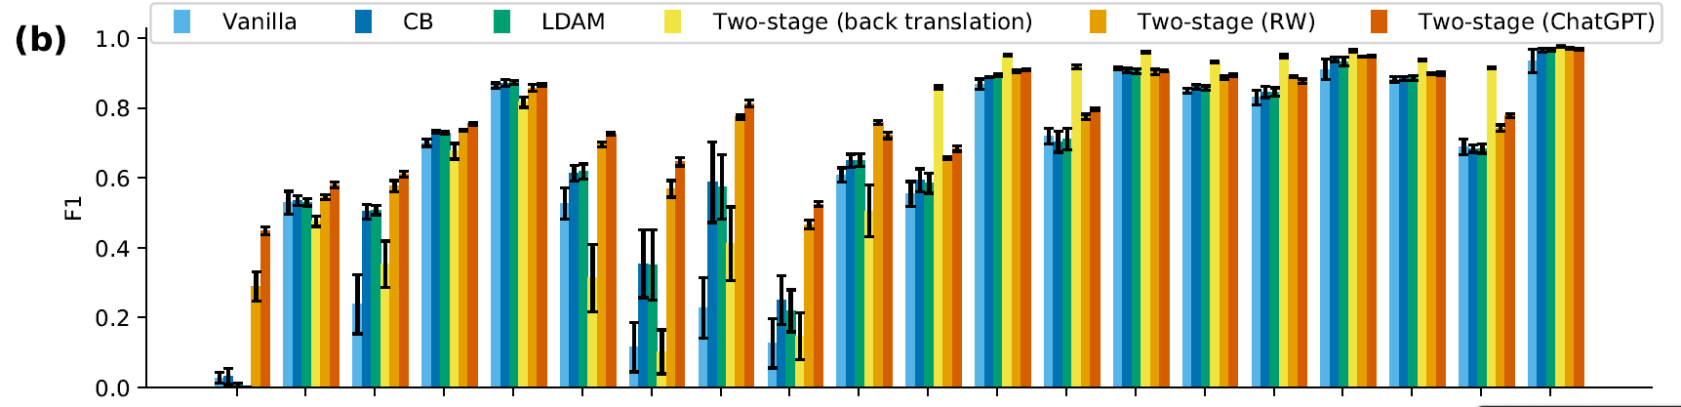
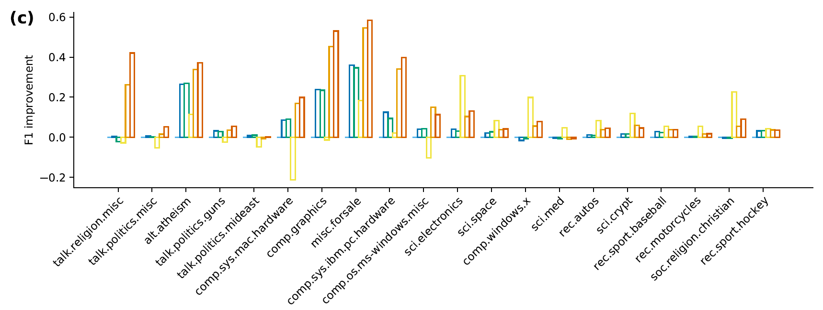
Newsgroups (step imbalance)
Performance boost

Slide 18
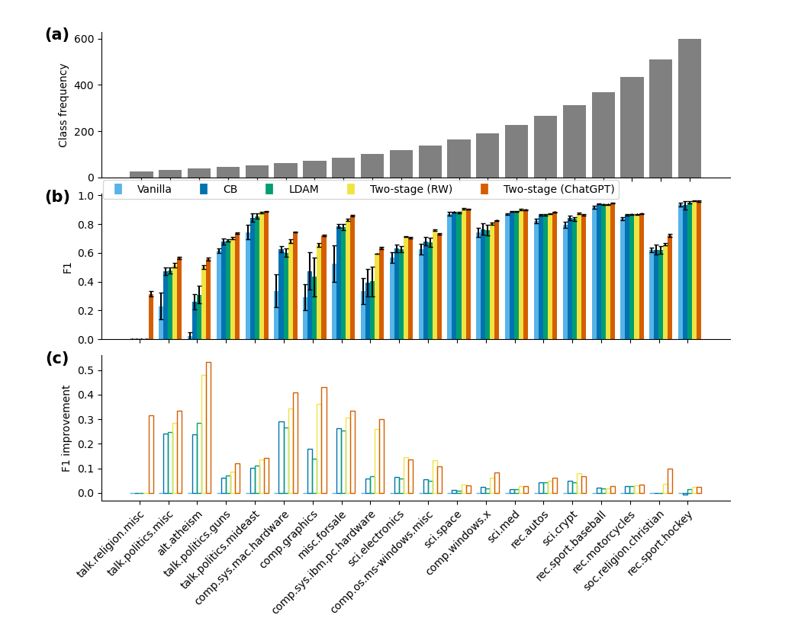
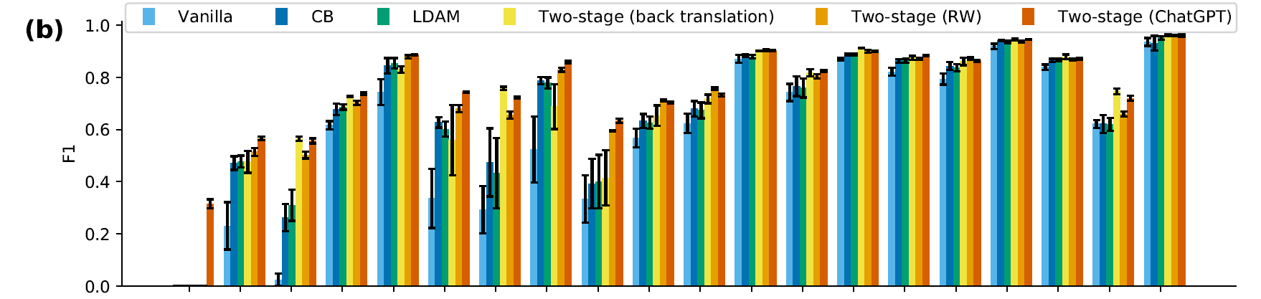
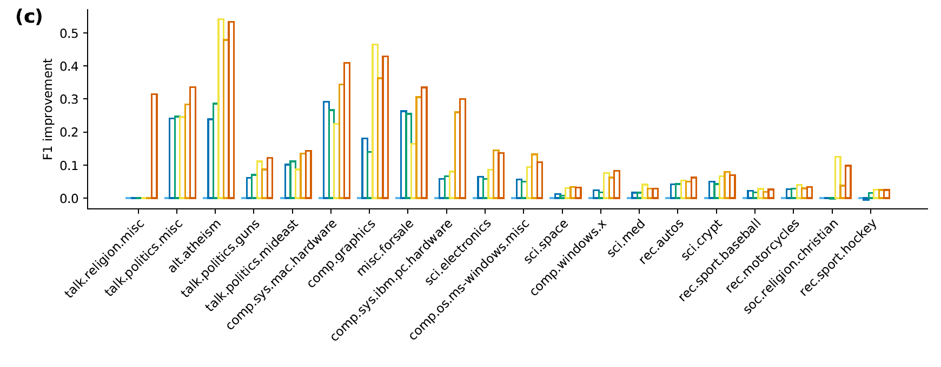
Newsgroups (long-tail imbalance)
Performance boost

Slide 19
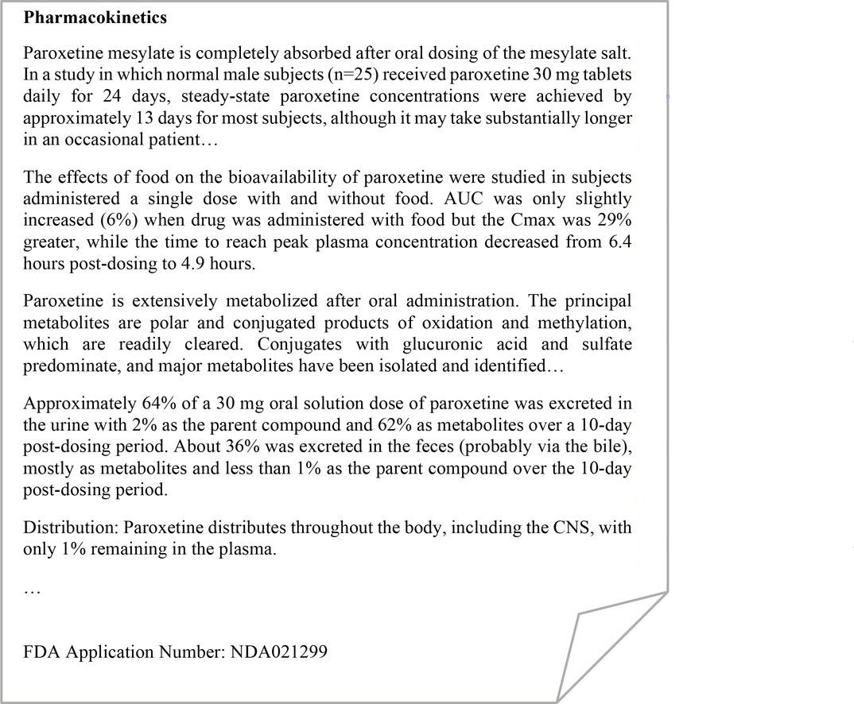
Real-World Application: ADME Semantic Labeling
Pharmacokinetics text classification
Enhance assessment of PSGs
FDA assessor needs to classify text into absorption, distribution, metabolism, excretion, and others
Multi-class text classification
Automating ADME classification can help the FDA assessor
Absorption
Absorption
Metabolism
Excretion
Distribution
Shi, Y., Wang, J., Ren, P., ValizadehAslani, T., Zhang, Y., Hu, M., & Liang, H. (2023). Fine-Tuning BERT for Automatic ADME Semantic Labeling in FDA Drug Labeling to Enhance Product-Specific Guidance Assessment. Journal of Biomedical Informatics, 104285.
19

Slide 20
Real-World Application: ADME Semantic Labeling
ADME classification
Naturally heavily imbalanced
Fine-tuning method​ | Macro F1​
Vanilla ​ | 0.9002 (0.0011)​
CB | 0.9014 (0.0016)​
LDAM | 0.9006 (0.0014)​
Two-stage (back translation) | 0.9144 (0.0010)
Two-stage (RW) ​ | 0.9122 (0.0021)​
Two-stage (ChatGPT) | 0.9130 (0.0015)

Slide 21
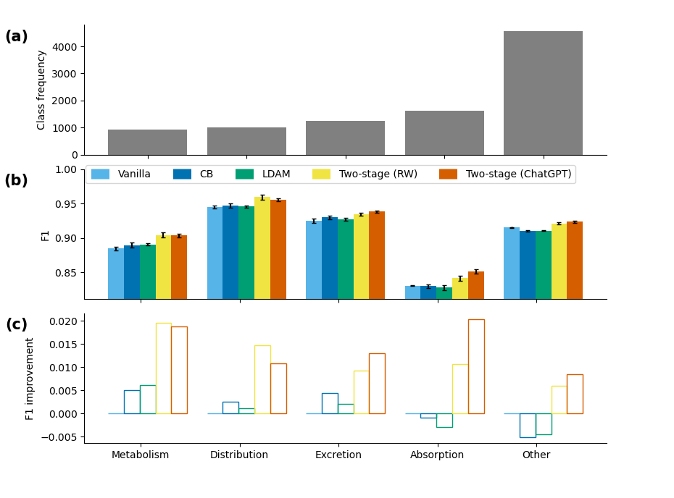
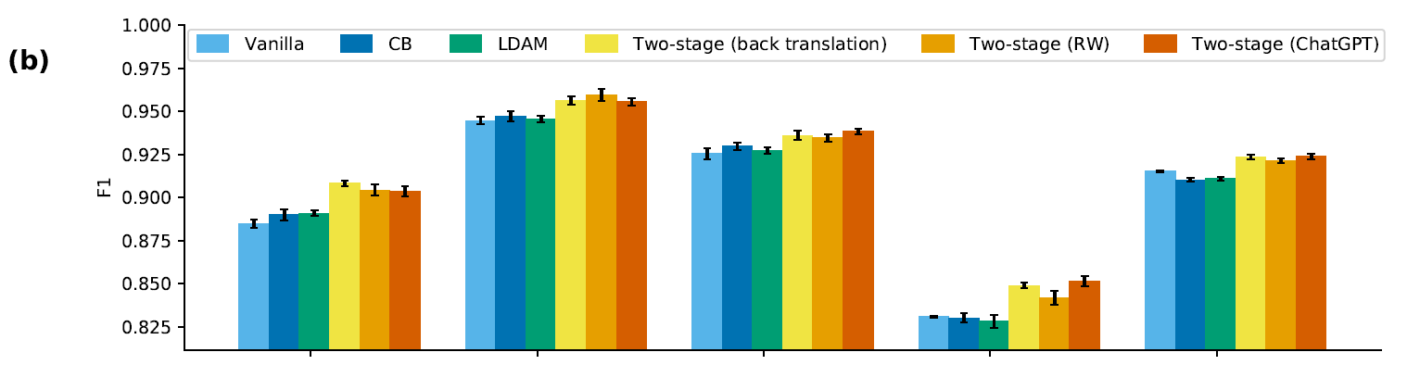
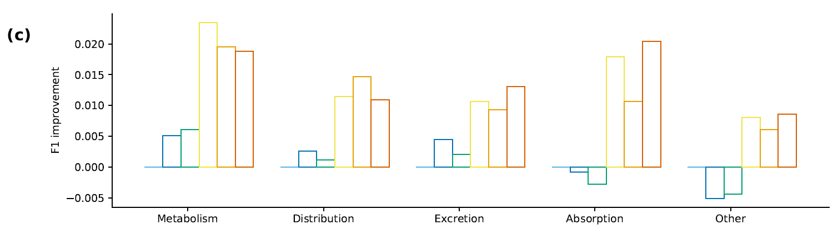
ADME
Performance boost

Slide 22
Augmented data quality control
Is the augmented data similar to the original data? To what extent?
Multiple experiments
Counting the number of words and sentences.
Cosine similarity of pre-trained BERT embeddings
Model | Number of words | Number of sentences | Cosine similarity
Original | 9.0070 (0.2373) | 1.0030 (0.0017) | 0.9292 (0.0032)
Augmented | 9.3080 (0.2229) | 1.0100 (0.0040)

Slide 23
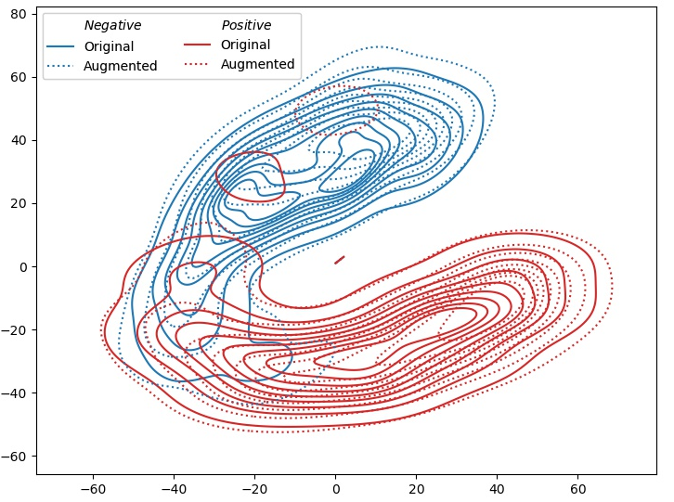
Evaluation of augmented data (another experiment)
Embeddings of fine-tuned BERT model
The hold-out test samples
t-SNE visualization

Slide 24
Ablation
Many factors: Two stage, ChatGPT data, training the topmost layer…
What is the contribution of each factor?
Ablation Experiments:
  Linear probing then full fine-tuning (LP-FT)
  Using ChatGPT data in both stages
  Vanilla fine-tuning with ChatGPT data
Step-imbalanced 20 Newsgroups
Fine-tuning method​ | F1
LP-FT | 0.7011 (0.0091)
Using ChatGPT data in both stages | 0.7562 (0.0037)
Vanilla fine-tuning ChatGPT data | 0.7530 (0.0026)
Two-stage (ChatGPT) | 0.7674 (0.0021)

Slide 25
Other models
So far, we only used BERT base
What about other models?
  bert-large-uncased
  RoBERTa-base
Step-imbalanced 20 Newsgroups
Fine-tuning method​ | bert-large-uncased | RoBERTa-base
Vanilla ​ | 0.7397 (0.0071) | 0.6781 (0.0064)
Two-stage (ChatGPT) | 0.7822 (0.0027) | 0.7722 (0.0027)

Slide 26
Conclusions
Real-world data may be class imbalanced
Learning challenge
Solution: Two-stage fine-tuning
  Stage 1: Train the topmost layer and classification head with ChatGPT augmented data
  Stage 2: Perform full fine-tuning with original data
Better performance than existing methods!

Slide 27

Thank you for your attention!

Slide 28
Original or Augmented
We trained the BERT model to distinguish the original data from augmented data
The model can do this with accuracy of 84%
However, the model might be using some artifacts of the pipeline, such as extra line breaks in the augmented data.

